Slide 1
5. Quantum Simulation
IBM Quantum Learning
1

Slide 2
Overview
Quantum simulation (Hamiltonian simulation, quantum dynamics)
Hamiltonian (Model)
Algorithms for Quantum Simulation
Trotterization
Hands-on Session
Algorithms for Quantum Simulation (if we have time…)
Randomization

Slide 3
Quantum Simulation?
3

Slide 4
















Quantum Simulation (Hamiltonian Simulation)
Solve the time-dependent Schrödinger equation
Wavefunction
Hamiltonian To compute this is the goal!
Solve the problem numerically as accurate and efficient as possible
Very small time slice
Taylor series as an example

Slide 5
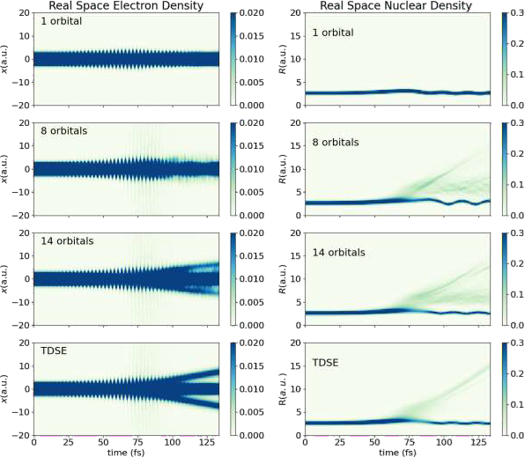
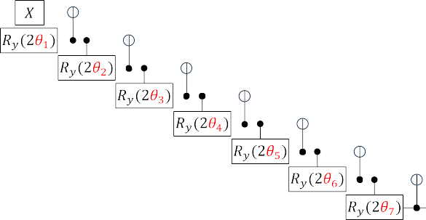


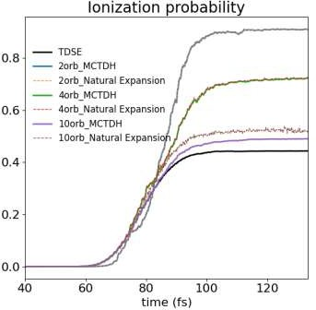
What can we do with quantum simulation:
Univ of Tokyo, Professor Sato
Electron and nuclear dynamics
Electron density 𝜌 𝑥
Nuclear density 𝜌 𝑅
x
Molecule in a strong laser field
𝑒
𝑛
Not entangled
X₁
R
X₂
𝑈 𝜽
⨂
⇆
ibm_kawasaki 8 qubits
2 qubits
ibm_kawasaki 14 qubits
4 qubits
10 qubits
Numerically exact
More accurate with more qubits
TDH (no correlation)

Slide 6


Why quantum simulation on quantum computers?
Storing the information of the wavefunction
Requires extremely large memory on the classical computer
Quantum computational resources (qubits) required to store them scale linear against the system size
One of the most important application on quantum computers
Quantum chemistry (material science)
High-energy physics

Slide 7
Quantum Simulation (Hamiltonian Simulation)
Solve the time-dependent Schrödinger equation
Wavefunction
Hamiltonian To compute this is the goal!
Solve the problem numerically as accurate and efficient as possible
Very small time slice
Taylor series as an example

Slide 8
Hamiltonian
8

Slide 9
Hamiltonian in general
Hamiltonian of a quantum system is an operator representing the total energy of the system
Kinetic energy and potential energy
Time-dependent Hamiltonian & time-independent Hamiltonian
We will consider only time-independent Hamiltonian today
Important in many fields
Quantum chemistry (material science)
Condensed matter physics
High-energy physics

Slide 10











Hamiltonian (Spin Hamiltonian)
Lattice models for spin systems to study magnetic systems
Spin interaction
External field
– n-vector models
– Ising model (n=1)
J
– XY model (n=2)
– Heisenberg model (n=3)
Complexity & Computational resources

Slide 11




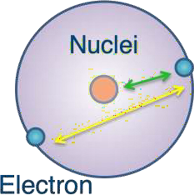












Hamiltonian (Fermionic Hamiltonian)
– Hubbard model
Describe conducting and insulating systems
U
t
U
Creation operator
Annhilation operator
– Quantum Chemistry Hamiltonian
Kinetic energy of electrons
Electron- nucleus attraction
Electron- electron repulsion
Complexity & Computational resources

Slide 12


































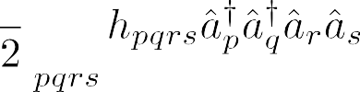


Mapping the Hamiltonian
Map the second-quantized Hamiltonian to qubits:
Hubbard, Quantum chemistry
Note that operators a and c are the same

Slide 13


















Jordan–Wigner Mapping
_{H}ˆ
∑
pq
h a a + ∑ h
Fermionic Hamiltonian
=
†
a† a†a a
M
pq p q
pqrs p q r s
pqrs
Creation operator
Jordan–Wigner mapping
Annhilation operator
Hydrogen molecule (bond length=0.735 Angstrom, STO-3G basis set. 4 spin orbitals and 36 terms)
How will this be mapped?

Slide 14






























Try mapping a one-body term
Use these relations
Let us try a one-body term as an example

Slide 15





































How about a two-body term?
Use these relations
The equations are tedious, but the idea is simple

Slide 16
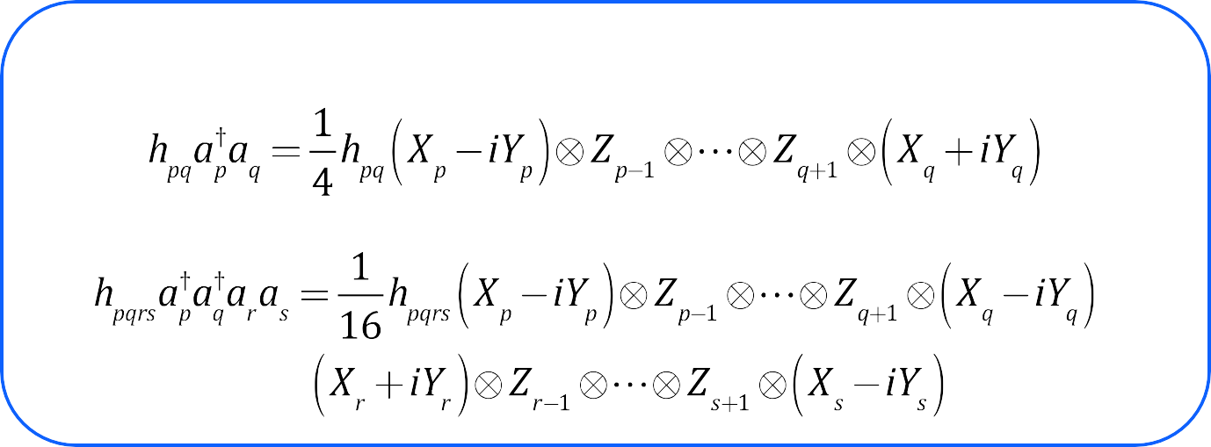































Mapping the Hamiltonian
General equation
Fermionic Hamiltonian

Slide 17
Algorithms for Quantum
Simulation
17

Slide 18










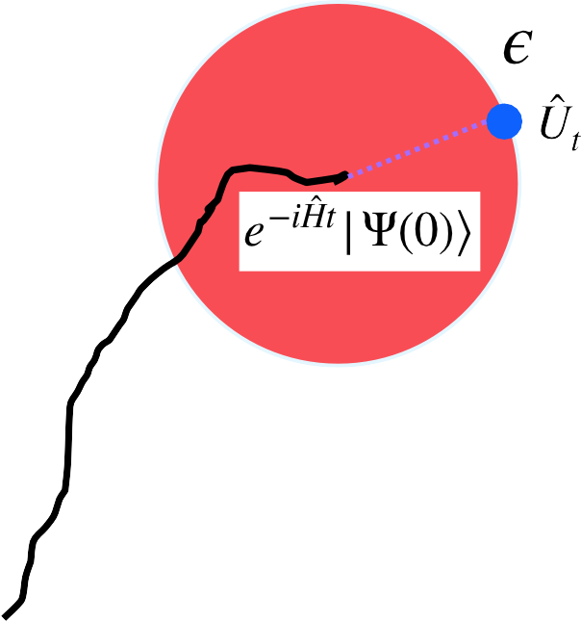














Algorithms for quantum simulations
The Hamiltonian is known, but how to compute is not trivial
It is extremely difficult to compute this exactly
We try to implement U such that
Operator norm
A linear operator
such that for any
is bounded if there exists a real number
The smallest M (size) that satisfies this requirement is the norm of the operator
Properties:
•
and
if and only if
•
•

Slide 19






Algorithms for quantum simulations
The Hamiltonian is known, but how to compute It is extremely difficult to compute this exactly We try to implement U such that
is not trivial
There are several strategies to compute it efficiently
Small error
Shallow circuit depth
Methods
Trotter formula
Randomization (QDrift)
”Post Trotter”
Linear combination of unitaries
Qubitization (quantum signal processing)

Slide 20















Trotterization
We here assume that the Hamiltonian is k-local (P are Pauli strings that act on at most “k” qubits)
Let us focus on a simple Hamiltonian
Lie Product Formula
We will take “n” to be finite
This only holds when H₁ and H₂ commute, but this is often not the case

Slide 21































Error in Trotterization (First order)
(Triangle inequality of the operator norm)

Slide 22

















Example: Trotterization (first-order) Transverse Ising model
h
J
N: Number of qubits
0
1
2
3

Slide 23
















Example: Trotterization (first-order) Transverse Ising model
J
h
0: up spin
1: down spin
Bit strings
0
0 1
Time evolution step
1
X X
Time evolution step
0
1
…
2
3
State preparation
By repeating this, we can get the wavefunction of time t

Slide 24


Example: Trotterization Transverse Ising model
Magnetization
h
J
X X
Time evolution step
Time evolution step
0
Z₀
1
…
Z₁
2
Z₂
3
Z₃
State preparation
Measure expectation values of observables

Slide 25












Suzuki-Trotter Formula (2nd order)
Hamiltonian (general form)
Second-order Suzuki–Trotter formula
Again, let us focus on a simple Hamiltonian

Slide 26


































Error in Suzuki-Trotter Formula (2nd order)
The Taylor expansion for each term (3rd order) in the 2nd order Suzuki-Trotter Formula
The exact Taylor expansion truncated at the 3rd order
Error of the second-order Suzuki-Trotter

Slide 27
















Example: Trotterization (second-order)
Transverse Ising model
h
J
0
1
2
3

Slide 28



Example: Trotterization (second-order)
Transverse Ising model
0
1
2
3
Time evolution step
X X
0
1
…
2
3
State preparation
By repeating this, we can get the wavefunction of time t

Slide 29



































Suzuki-Trotter recursion formula for higher order
Second-order Suzuki–Trotter formula
Recursion relation
Fourth order Suzuki–Trotter

Slide 30



Trotterization
The method is intuitive and easy to implement
Number of qubits required is minimal (no ancilla required)
The scaling of the gate depth against the error is not optimal
First-order Trotterization scaling:
Second-order Suzuki-Trotter scaling:
L: Number of terms in the Hamiltonian
t: time

Slide 31
Connection with other lectures
Lecture 5: Quantum Phase Estimation
Quantum simulation can be a subroutine
The energy will emerge as the shift in the phase
Using the quantum chemistry Hamiltonian, we can get an accurate energy value of a molecule
Lecture 6: Variational Quantum Eigensolver
We can use the quantum-classical hybrid algorithm to get energies and other physical properties
QAOA circuits are extremely similar with the time-evolution circuits
For utility experiments
Time-evolution circuits play an important role

Slide 32
Hands-on session
Quantum simulation with an ideal simulator
Monitoring time evolution of an observable
“Estimator” in Qiskit
Quantum simulation with a quantum hardware
Time evolution of the wavefunction
“Sampler” in Qiskit

Slide 33




















Randomization
Childs, Ostrander, Su, arXiv: 1805.08385
A
C
A
B
B
C
These sequences have the same error bound

Slide 34
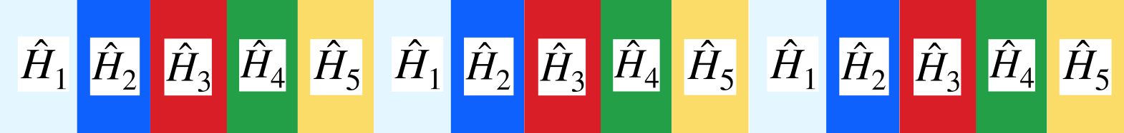


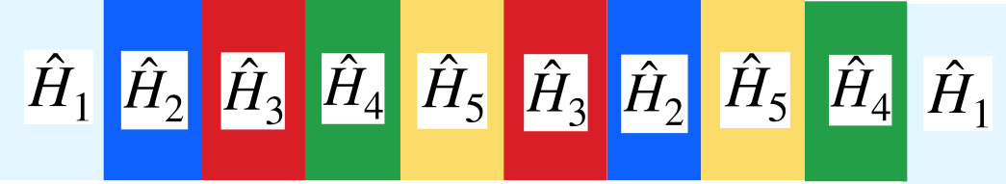








Trotterization vs Randomization
Conventional Trotterization (first order)
Randomization
Can we average out the errors by randomly selecting the ordering?

Slide 35
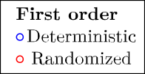
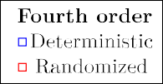
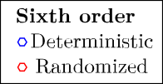


















Performance of randomization
(time steps required to achieve a given accuracy)
Childs, Ostrander, Su, arXiv: 1805.08385
Time step
System size
Calculation using a Heisenberg model
Randomization is effective for Trotterization of low order (good for near term)

Slide 36






QDrift
Campbell, Phys Rev Lett 123, 070503 (2019)
Randomization
Let us try to average out the error further
Can we make it applicable to systems with large number of terms?
Sample
with weights

Slide 37


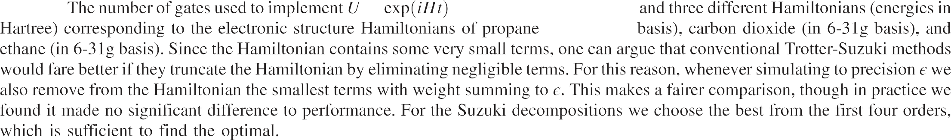




Performance of Qdrift
(gate counts required to achieve a given accuracy)
Campbell, Phys Rev Lett 123, 070503 (2019)
Performance is better than randomization only
Powerful for Hamiltonians with large number of terms

Slide 38
Randomization
Scaling does not depend on the number of terms (QDrift)
Advantageous for Hamiltonians with large number of terms (quantum chemistry)

Slide 39
Further Reading
“Quantum Computation and Quantum Information”, Michael A. Nielsen and Isaac L. Chuang, Cambridge
University Press.
“Quantum Information Science”, Riccardo Manenti and Mario Motta, Oxford University Press.

Slide 40
Overview
Quantum simulation (Hamiltonian simulation, quantum dynamics)
Hamiltonian (Model)
Algorithms for Quantum Simulation
Trotterization
Hands-on Session
Algorithms for Quantum Simulation (if we have time…)
Randomization

